Slide 1


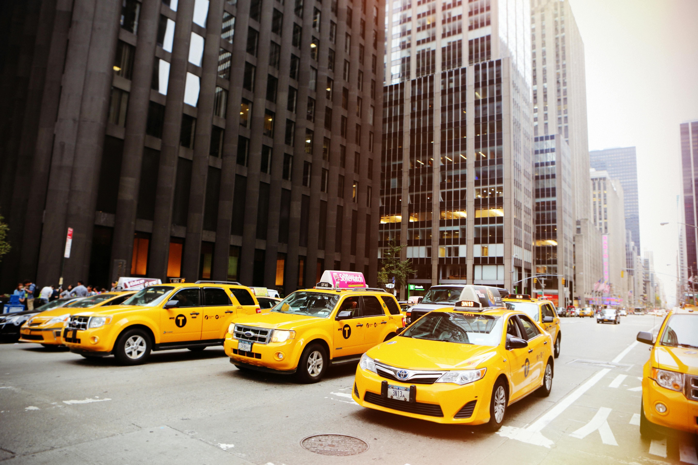
CODE BASICS RESUME PROJECT CHALLENGE 13
TRANSPOTATION &MOBILITY
Submitted by:
B. Vasantha Pyari

Slide 2
AGENDA
Problem Statement
About Company
About Data Model
Primary Questions
Dashboard
Ad Hoc Requests
Secondary Questions

Slide 3
PROBLEM STATEMENT
Goodcabs, a cab service company established two years ago, has gained a strong foothold in the Indian market by focusing on tier-2 cities. Unlike other cab service providers, Goodcabs is committed to supporting local drivers, helping them make a sustainable living in their hometowns while ensuring excellent service to passengers. With operations in ten tier-2 cities across India, Goodcabs has set ambitious performance targets for 2024 to drive growth and improve passenger satisfaction.
As part of this initiative, the Goodcabs management team aims to assess the company's performance across key metrics, including trip volume, passenger satisfaction, repeat passenger rate, trip distribution, and the balance between new and repeat passengers.

Slide 4
ABOUT COMPANY
Mission: Goodcabs aims to revolutionize urban transportation by providing safe, reliable, and affordable ride-hailing services, ensuring high customer satisfaction and efficient operations for drivers and passengers alike.
Operational Highlights:
City-Wide Service
Data-Driven Operations
Passenger Loyalty
Key Services:
On-Demand Rides
Passenger-Focused Experience
Driver Collaboration
Core Values:
Customer-Centric Approach
Sustainability
Innovation

Slide 5
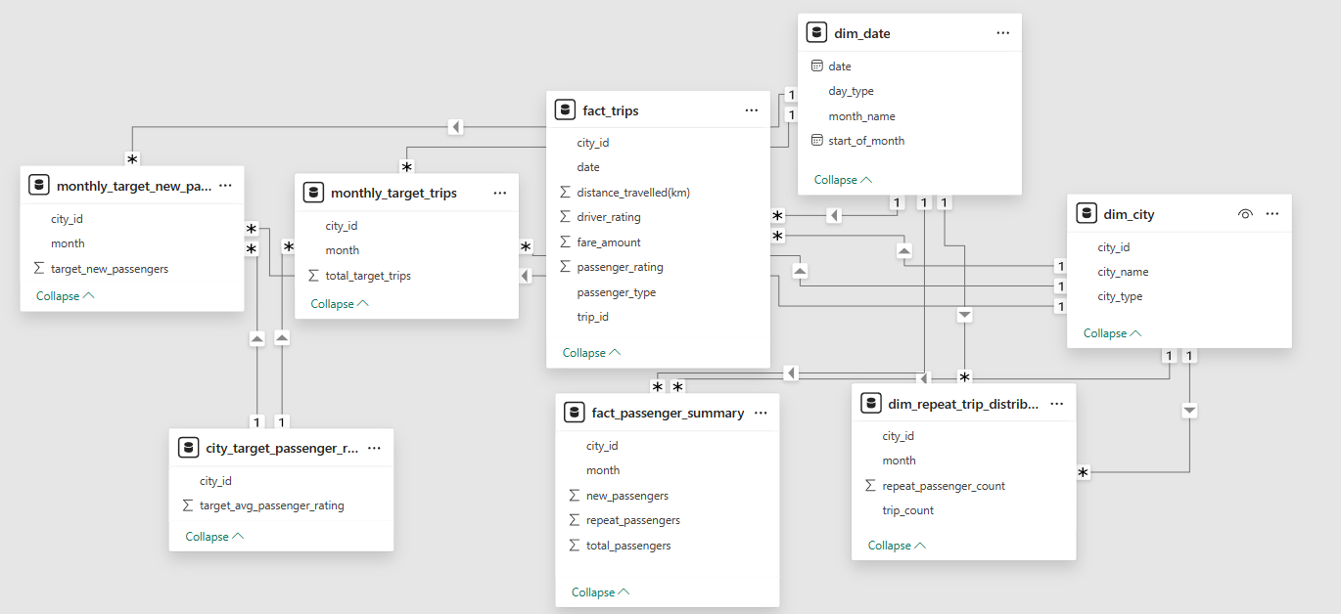
DATA MODEL

Slide 6
PRIMARY QUESTIONS

Slide 7
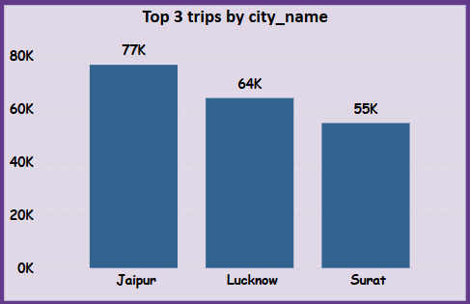
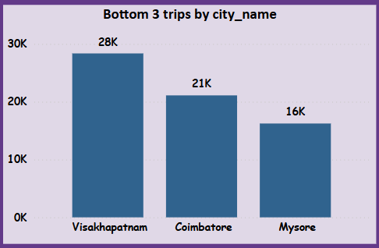
1. Top and Bottom Performing Cities
Identify the top 3 and bottom 3 cities by total trips over the entire analysis period.

Slide 8
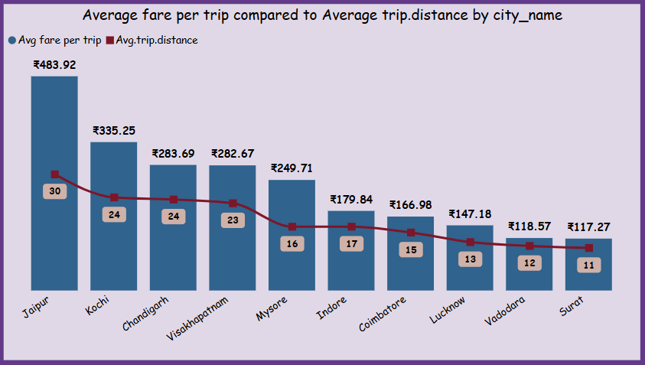
2. Average Fare per Trip by City
Calculate the average fare per trip for each city and compare it with the city's average trip distance. Identify the cities with the highest and lowest average fare per trip to assess pricing efficiency across locations.

Slide 9
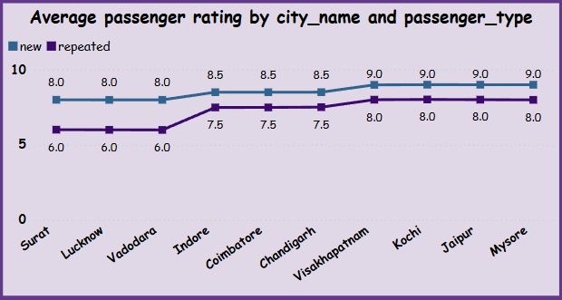
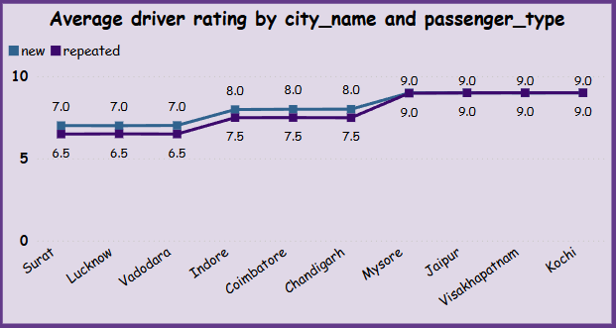
3. Average Ratings by City and Passenger Type
Calculate the average passenger and driver ratings for each city, segmented by passenger type (new vs. repeat). Identify cities with the highest and lowest average ratings.

Slide 10
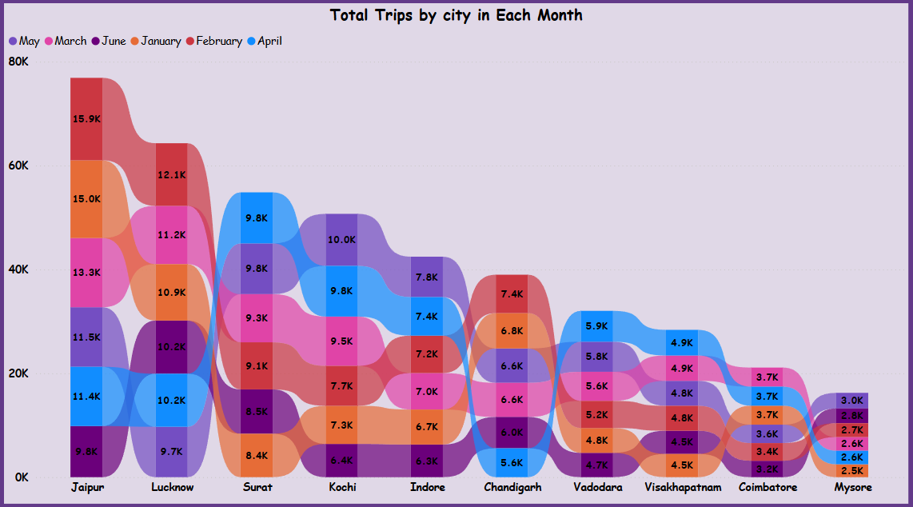
4. Peak and Low Demand Months by City
For each city, identify the month with the highest total trips (peak demand) and the month with the lowest total trips (low demand).

Slide 11
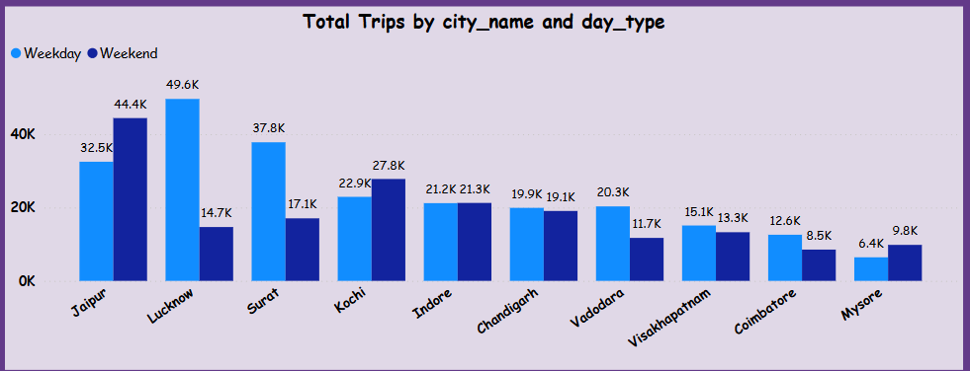
5. Weekend vs. Weekday Trip Demand by City
Compare the total trips taken on weekdays versus weekends for each city over the six-month period. Identify cities with a strong preference for either weekend or weekday trips to understand demand variations.

Slide 12
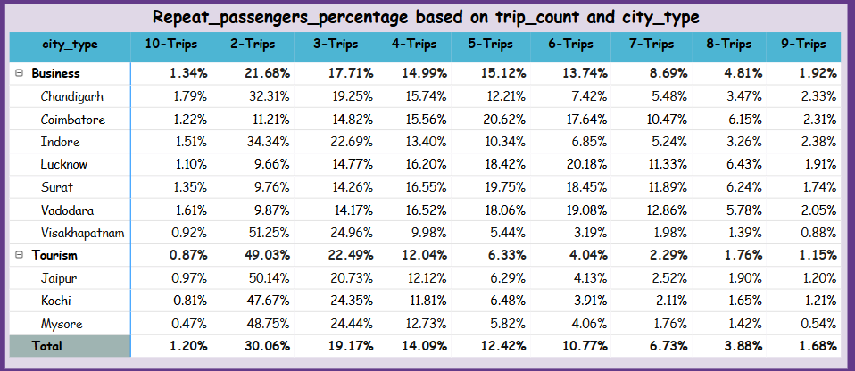
6. Repeat Passenger Frequency and City Contribution Analysis
Analise the frequency of trips taken by repeat passengers in each city (e.g., % of repeat passengers taking 2 trips, 3 trips, etc.). Identify which cities contribute most to higher trip frequencies among repeat passengers and examine if there are distinguishable patterns between tourism-focused and business-focused cities.

Slide 13
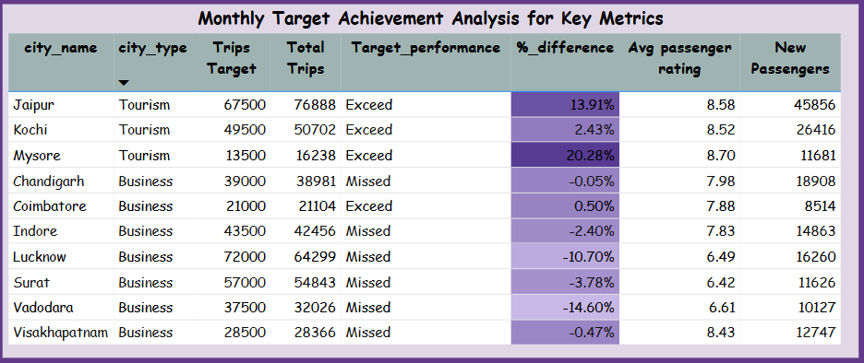
7. Monthly Target Achievement Analysis for Key Metrics
For each city, evaluate monthly performance against targets for total trips, new passengers, and average passenger ratings from targets db. Determine if each metric met, exceeded, or missed the target, and calculate the percentage difference. Identify any consistent patterns in target achievement, particularly across tourism versus business-focused cities.

Slide 14
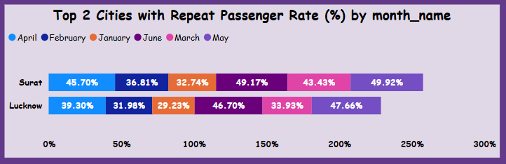
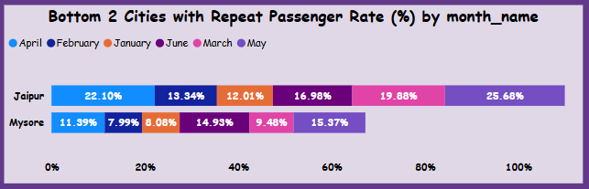
8. Highest and Lowest Repeat Passenger Rate (RPR%) by City and Month
Analyse the Repeat Passenger Rate (RPR%) for each city across the sixmonth period. Identify the top 2 and bottom 2 cities based on their RPR% to determine which locations have the strongest and weakest rates

Slide 15
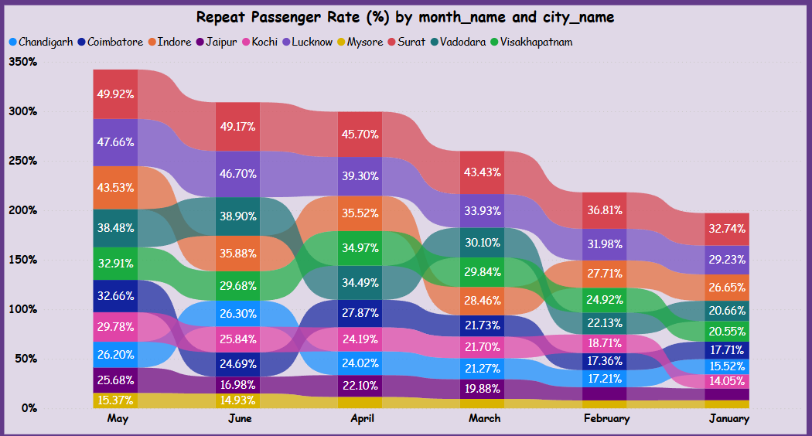
Analyse the RPR% by month across all cities and identify the months with the highest and lowest repeat passenger rates. This will help to pinpoint any seasonal patterns or months with higher repeat passenger loyalty

Slide 16


Slide 17
AD_HOC REQUESTS

Slide 18
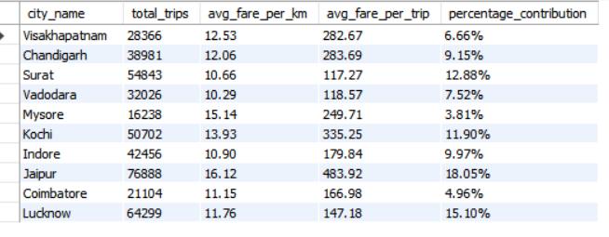
Business Request - 1: City-Level Fare and Trip Summary Report

Slide 19
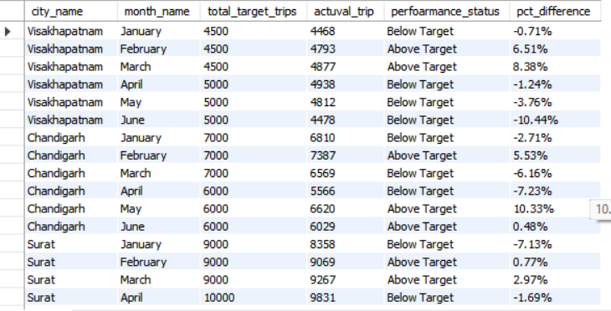
Business Request - 2: Monthly City-Level Trips Target Performance Report

Slide 20
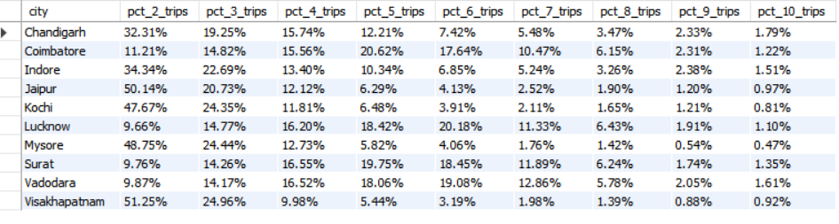
Business Request - 3: City-Level Repeat Passenger Trip Frequency Report

Slide 21
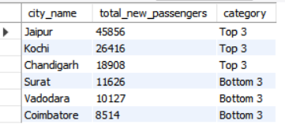
Business Request - 4: Identify Cities with Highest and Lowest Total New Passengers

Slide 22
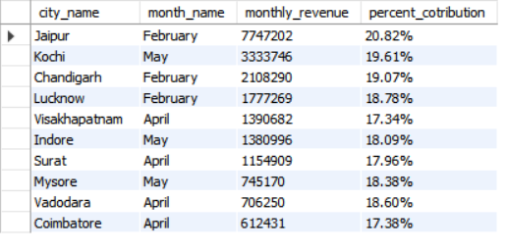
Business Request - 5: Identify Month with Highest Revenue for Each City

Slide 23
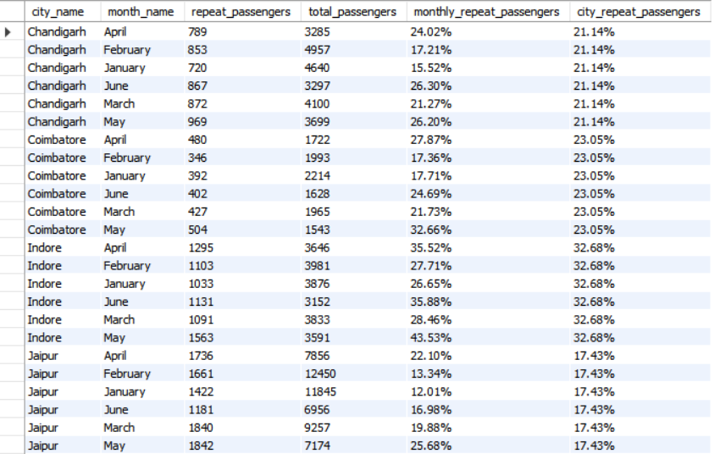
Business Request - 6: Repeat Passenger Rate Analysis

Slide 24
SECOUNDRY QUESTIONS

Slide 25



Factors Influencing Repeat Passenger Rates
What factors (such as quality of service, competitive pricing, or city demographics) might contribute to higher or lower repeat passenger rates in different cities?
Quality of service
Competitive pricing
City demographics
Age
Income
Education
Population density
Cultural diversity
Reliability
Comfort
customer support
safety
Fare competitiveness
Value add services
Discounts and promotions
Flexibility

Slide 26


Factors that Are correlations with socioeconomic or lifestyle patterns in these cities?
Socioeconomic patterns
Lifestyle Patterns
Income
Education
Occupation
Urbanization
Commuting habits
Tourism

Slide 27


2. Tourism vs. Business Demand Impact
How do tourism seasons or local events (festivals, conferences) impact Goodcabs' demand patterns? Would tailoring marketing efforts to these events increase trip volume in tourism-oriented cities?
Tourism Seasons
Local Events
Peak seasons
Off-season
Shoulder season
Increased Demand
Surge pricing
Event-specific services
Tailoring Effects to Events
Event-based marketing
Partnerships
Dynamic pricing
Increased supply
Real-time updates

Slide 28
3. Emerging Mobility Trends and Goodcabs' Adaptation o What emerging mobility trends (such as electric vehicle adoption, green energy use) are impacting the cab service market in tier-2 cities? Should Goodcabs consider integrating electric vehicles or eco-friendly initiatives to stay competitive?
Rising Electric Vehicle Adoption
Shift to Green Energy and Sustainability
Digitization and Technology in Mobility
Affordable Mobility for Middle-Class Consumers
Impact on Cab Service Market
Environmental Benefits
Cost Savings
Customer Preference.
Regulatory Support
Flexibility :Options for changes or cancellations.
Should Goodcabs consider integrating electric vehicles or eco-friendly initiatives to stay competitive?
Enhanced Brand Image
Cost Efficiency.
Regulatory Compliance
Market Differentiation

Slide 29



4. Partnership Opportunities with Local Businesses
Are there opportunities for Goodcabs to partner with local businesses (such as hotels, malls, or event venues) to boost demand and improve customer loyalty? Could these partnerships drive more traffic, especially in tourism heavy or high-footfall areas?
Partnership Ideas
Benefits
Implementation
Hotel Partnerships
Mall and Shopping Center Partnerships
Event Venue Partnerships
Restaurant and Bar Partnerships
Tour Operator Partnerships
Increased Demand
Improved Customer Loyalty
Enhanced Customer Experience
Revenue Growth
Identify Potential Partners
Develop a Partnership Proposal
Establish a Partnership Agreement
Promote the Partnership

Slide 30




5. Data Collection for Enhanced Data-Driven Decisions
To make Goodcabs more data-driven and improve its performance across key metrics (such as repeat passenger rate, customer satisfaction, new passengers and trip volume), what additional data should Goodcabs collect? Consider data that could provide deeper insights into customer behavior, operational efficiency, and market trends.
Customer Behavior
Operational Efficiency
Market Trends
Additional Data Resources
Trip purpose
Passenger demographics
Customer feedback Tour
Driver performance metrics
Vehicle utilization
Service time and wait times
Competitor analysis
Market demand.
Geospatial data
GPS and location data.
Payment and transaction data
Social media and online reviews

Slide 31
THANK YOU

